Slide 1


Slide 2



IaC w Azure Bicep vs. Terraform
Jakub Ramut
Cloud Architect & Consultant
@Chmurowisko

Slide 3



Jakub Ramut
Cloud Architect & Consultant
e: jakub.ramut@chmurowisko.pl
Developer, architekt, team/tech Leader od ponad 10 lat związany z technologiami MS
Azure Cloud Architect w Chmurowisko
Fan automatyzacji, podejścia ”everything as a code” i wyznawca zasady “fail fast”
Microsoft MCT, Azure Architect Expert, Azure DevOps Expert

Slide 4

IaC w Azure
1
IaC
Bicep
Terraform
4
Fight!
Summary & Q/A
2
5
3

Slide 5
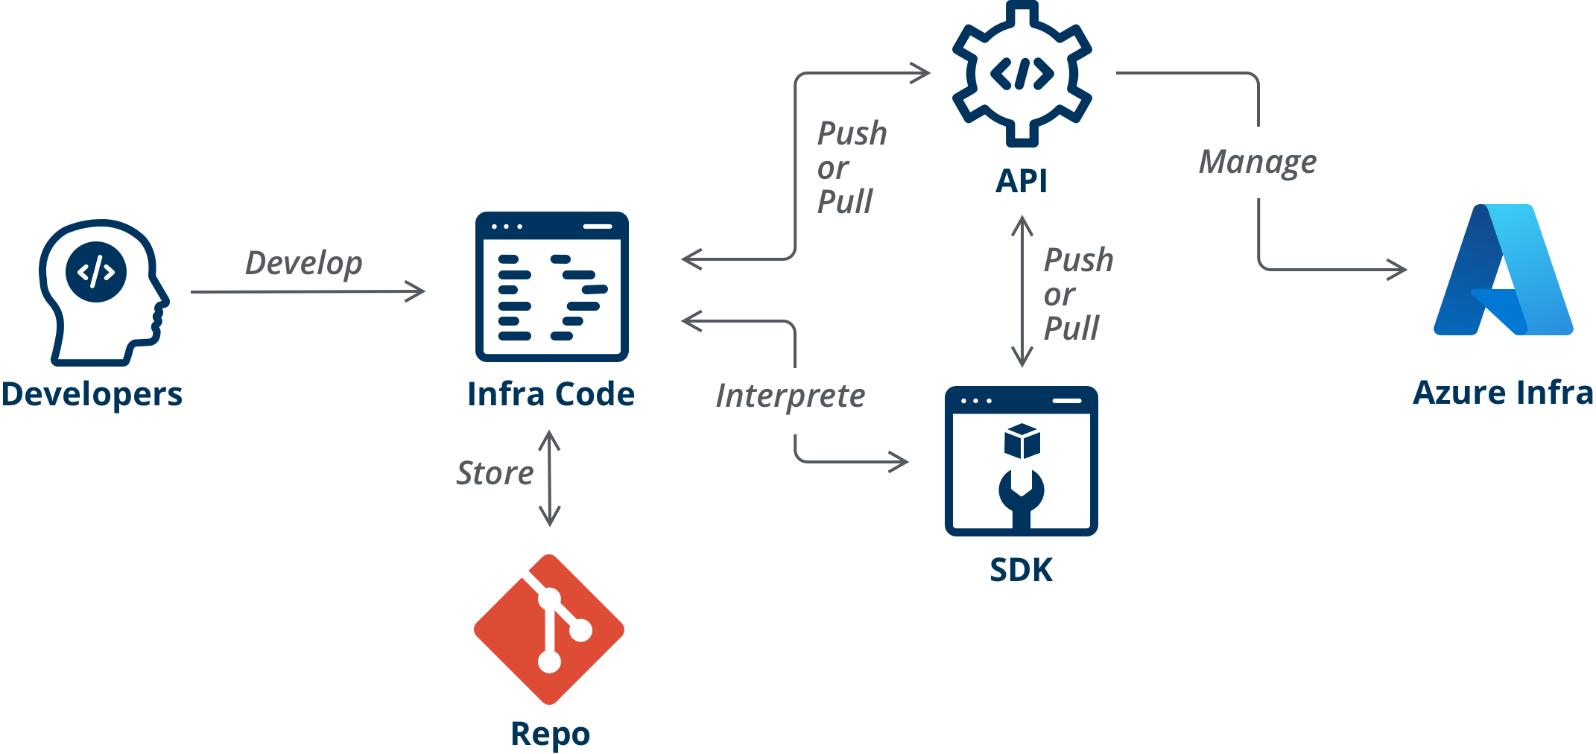
Infrastructure
as a Code
Gives consistency & efficiency
Reduces cost & risk
Introduces a development cycle

Slide 6
IaC w Azure
1
IaC
Bicep
Terraform
4
Fight!
Summary & Q/A
2
5
3

Slide 7
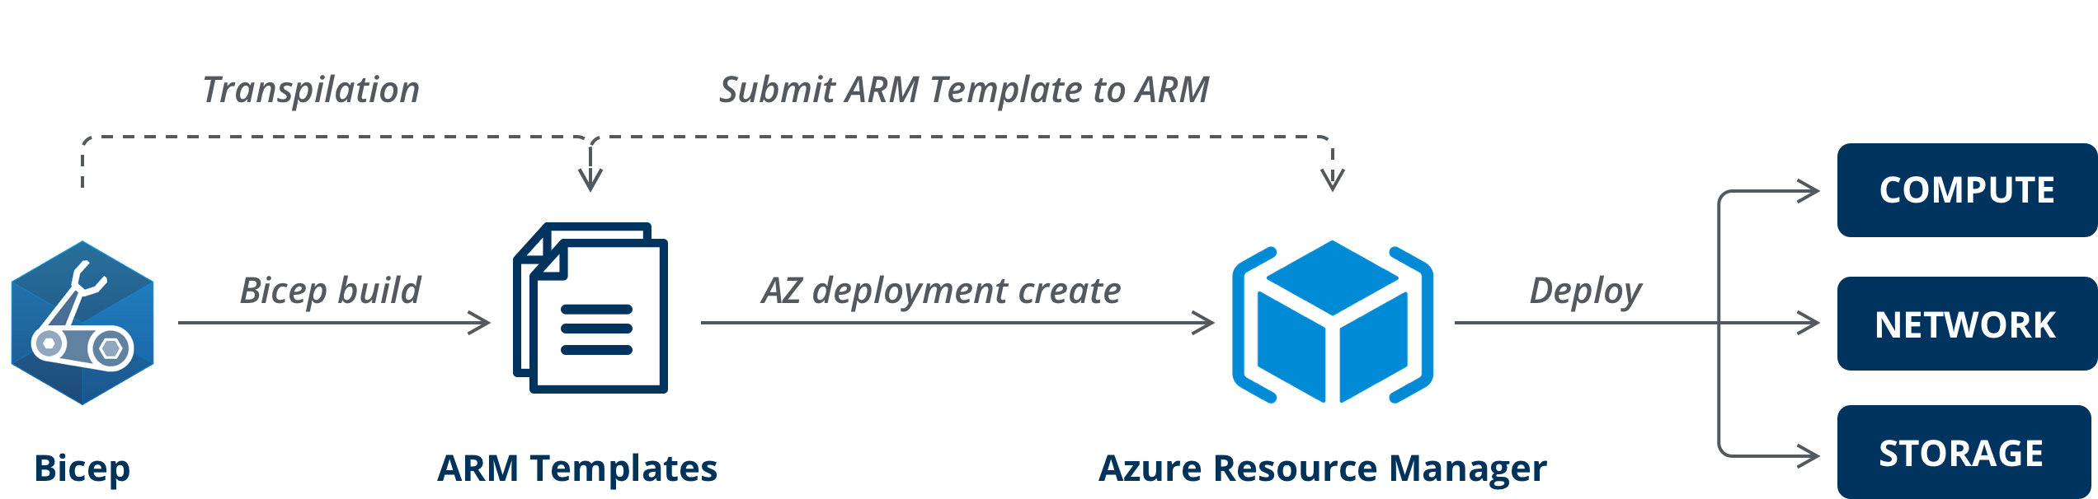
Bicep

Slide 8
Bicep pros:
Native solution – new features (from “day zero”) and full support
There is no state management – makes it easy to collaborate
Simplifies ARM templates, makes a transition from ARM to Bicep as easy as possible
Steep (short) learning curve for ARM users

Slide 9

Bicep cons:
Limited to Azure
Not widely used
Blood – related with ARM Templates

Slide 10
IaC w Azure
1
IaC
Bicep
Terraform
4
Fight!
Summary & Q/A
2
5
3

Slide 11
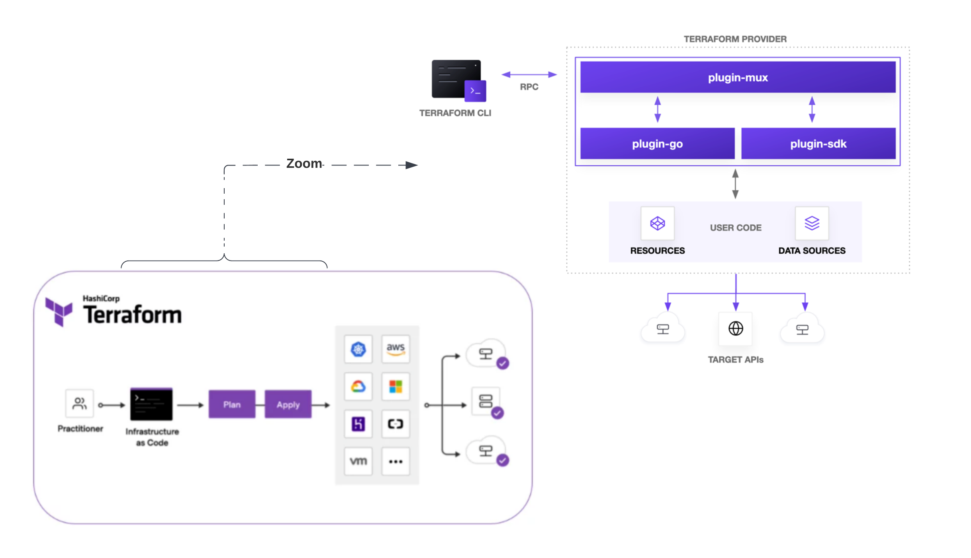
Terraform

Slide 12
Terraform pros:
Multi cloud/platform support, uniform syntax
Highly expandable — plugin-based
Community support — widely used, a market standard for IaC

Slide 13
Terraform cons:
Delayed support for new services or features
Time – may take some time to process for larger environments
Secret management
State file

Slide 14
IaC w Azure
1
IaC
Bicep
Terraform
4
Fight!
Summary & Q/A
2
5
3
Notes:
Validation – decorators vs. validation
Validation – during what-if and compare to tf plan (based on policies)
Chicken and egg problem – aks with managed identity and access to key vault
Update of resources (provider vs resource api)
Deletion of resources (with complete mode)
Guid and role assignment

Slide 15

Fight!
DEMO
DEMO

Slide 16
IaC w Azure
1
IaC
Bicep
Terraform
4
Fight!
Summary & Q/A
2
5
3

Slide 17
?
Q&A
Q&A

